Slide 1
BIT 353 ARTIFICIAL INTELLIGENCE
Lecturer: Saroj Poudel
Qualification: MS CIS&IT
Profession: Senior Software Developer/CTO
Lincoln University College, CN 1221

Slide 2


What are we learning?
Introduction to Intelligent Agent
Properties of Agent
Sensor / Actuator / effectors and actions
Types of Agents
Properties of Task Environments

Slide 3
Agent
An AI system is composed of an agent and its environment.
The agents act in their environment.
The environment may contain other agents
An agent is anything that can be viewed as:
perceiving its environment through sensors and
acting upon that environment through actuators

Slide 4
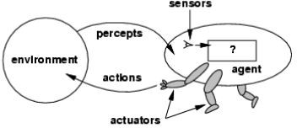
Architecture of an agent

Slide 5
Agent Terminologies
Performance Measure:
Determines how successful the agent is.
Behavior:
activities the agent performs to achieve the goal
Percepts:
formation of concepts based on the inputs.
Percept Sequence:
set of all the perceptions till date
Agent Function:
mapping of perception

Slide 6
Agent’s structure
Agent = Architecture + Agent Program
✔Architecture = the machinery that an agent executes on.
✔Agent Program = an implementation of an agent function
Agent Function
The agent function maps from percept sequences to actions:
The agent program runs on the physical architecture to produce f.

Slide 7
Example of Agents
Human agent( Powered by muscles)
Eyes, ears, skin, taste buds, etc. for sensors
Hands, fingers, legs, mouth, etc. for actuators
Robot ( Powered by motors)
Camera, infrared, bumper, etc. for sensors
Grippers, wheels, lights, speakers, etc. for actuators
Software agent ( Powered By Information and Results)
Functions as sensors
Functions as actuators

Slide 8
Intelligent agents
An Intelligent Agent is an autonomous entity which observes through sensors and acts upon an environment using actuators and directs its activities towards achieving the goal.
Hence, an agent gets percepts one at a time, and maps this percept sequence to actions.

Slide 9
Properties of Task Environments
Fully Observable vs Partially Observable
If an agent’s sensors give it access to the complete state of the environment at each point in time, then we say that the task environment is fully observable.
Fully observable environments are convenient because the agent need not maintain any internal state to keep track of the world.
An environment might be partially observable because of noisy and inaccurate sensors or because parts of the state are simply missing from the sensor data
Example of fully observable chess game, partially observable – autonomous vehicle

Slide 10
SINGLE-AGENT VS. MULTIAGENT
An agent solving problem on its own is said to be in single agent environment
Example: An agent solving a crossword puzzle by itself
An agent playing chess is in a two agent environment

Slide 11
Deterministic vs. nondeterministic
If the next state of the environment is completely determined by the current state and the action executed by the agent(s), then we say the environment is deterministic; otherwise, it is nondeterministic.
Taxi driving is clearly nondeterministic in this sense, because one can never predict the behavior of traffic exactly

Slide 12
EPISODIC VS. SEQUENTIAL
In an episodic task environment, the agent’s experience is divided into atomic episodes.
The next episode does not depend on the actions taken in previous episodes.
Example: an agent that has to spot defective parts on an assembly line bases each decision on the current part.
In sequential environments, on the other hand, the current decision could affect all future decisions.
Chess and taxi driving are sequential.

Slide 13
STATIC VS. DYNAMIC
If the environment can change while an agent is deliberating, then we say the environment is dynamic for that agent; otherwise, it is static.
Taxi driving is clearly dynamic.
Crossword puzzles are static.

Slide 14
DISCRETE VS. CONTINUOUS
The discrete/continuous distinction applies to the state of the environment, to the way time is handled, and to the percepts and actions of the agent.
For example, the chess environment has a finite number of distinct states
Taxi driving is a continuous-state and continuous-time problem: the speed and location of the taxi and of the other vehicles sweep through a range of continuous values and do so smoothly over time

Slide 15
KNOWN VS. UNKNOWN
Strictly speaking, this distinction refers not to the environment itself but to the agent’s (or designer’s) state of knowledge about the “laws of physics” of the environment
In a known environment, the outcomes for all actions are given.
It is quite possible for a known environment to be partially observable—for example, in solitaire card games, I know the rules but am still unable to see the cards that have not yet been turned over.
Conversely, an unknown environment can be fully observable—in a new video game, the screen may show the entire game state but I still don’t know what the buttons do until I try them.

Slide 16
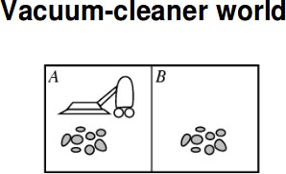
Percepts:
location and state of the environment, e.g., [A,Dirty], [B,Clean]
Actions:
Left, Right, Suck, No Op

Slide 17
Properties of Agent
Autonomous
Interacts with other agents plus the environment
Reactive to the environment
Pro-active (goal- directed)

Slide 18
Types of Agent
There are several kinds of agent programs which try to There are several kinds of agent programs which try to meet these conditions:
Simple Reflex Agent
Model-based Reflex Agent
Goal-based Agent
Utility-based Agent

Slide 19
Simple Reflex Agent
These agents select actions on the basis of the current percept, ignoring the rest of the percept history.
For example, the vacuum agent can be a simple reflex agent, because its decision is based only on the current location and on whether that location contains dirt.

Slide 20
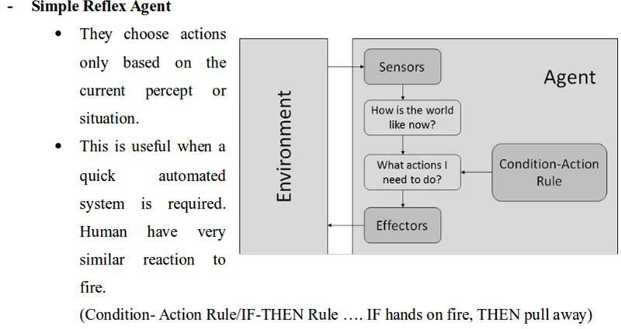

Slide 21
Model-based reflex agents
The most effective way to handle partial observability is for the agent to keep track of the part of the world it can’t see now.
That is, the agent should maintain some sort of internal state that depends on the percept history and thereby reflects at least some of the unobserved aspects of the current state.
While changing lanes, the agent needs to keep track of where the other cars are if it can’t see them all at once. And for any driving to be possible at all, the agent needs to keep track of where its keys are.

Slide 22
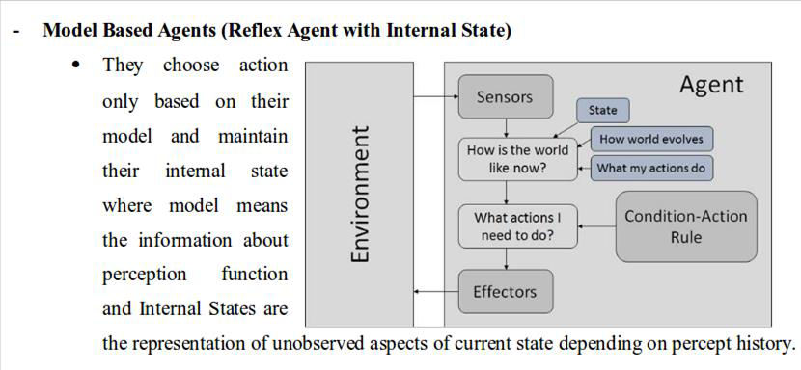

Slide 23
Goal-based agents
At a road junction, the taxi can turn left, turn right, or go straight on. The correct decision depends on where the taxi is trying to get to.
A goal-based agent brakes when it sees brake lights because that’s the only action that it predicts will achieve its goal of not hitting other cars.

Slide 24
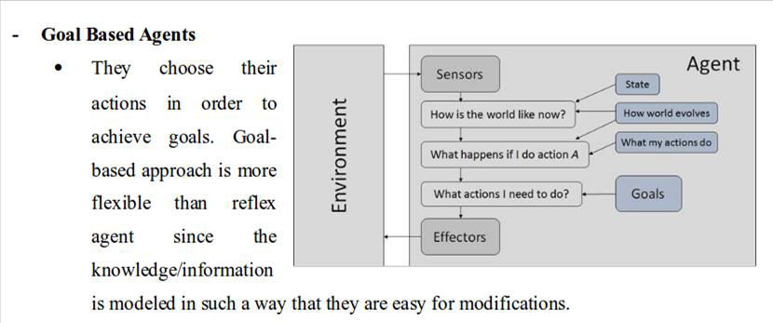

Slide 25
Utility-based agents
a rational utility-based agent chooses the action that maximizes the expected utility of the action outcomes
For example, many action sequences will get the taxi to its destination (thereby achieving the goal), but some are quicker, safer, more reliable, or cheaper than others

Slide 26
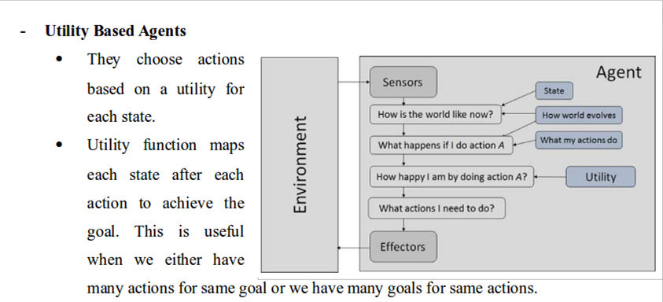

Slide 27
Task Environments
essentially the “problems” to which rational agents are the “solutions.”
The nature of the task environment directly affects the appropriate design for the agent program.

Slide 28
PEAS
To design a rational agent we must specify its task environment.
Standing for performance, environment, actuators and sensors, PEAS define task environments about formulating the performance of intelligent agents.

Slide 29
